Slide 1

CART Benefits Module
Draft-Version2
Conservation Planning
(Environmental) Benefits
February 2021

Slide 2
Environmental Benefits and Outcomes
Environmental Benefits
Environmental Benefits => as outlined in the 2018 Farm Bill directs NRCS to prioritize Conservation Planning and Program Delivery (e.g. most conservation for least cost)
Outcomes => as outlined in the 2018 Farm Bill directs NRCS to articulate more than Conservation Outputs (i.e. # of Contracts, Acres Treated, Dollars Invested)
Both Environmental Benefits and Outcomes can be represented similarly (e.g. tons of soil saved, expected nutrient load reductions, energy savings, etc.)
Environmental Benefits and Outcomes are both referenced repeatedly in the 2018 Farm Bill

Slide 3
Environmental Benefits and Outcomes
Environmental Benefits
Both Environmental Benefits and Outcomes should be based on science
Environmental Benefits => responsibility of the Conservation Planning and Technical Assistance Division
Outcomes => responsibility of the Resource Inventory and Assessment Division
Conservation Planning Benefits = Environmental Benefits

Slide 4
Environmental Benefits and Outcomes
Objectives
Provides clear roles for Environmental Benefits and Outcomes within NRCS
Facilitates the integration of Conservation Planning (Environmental Benefits) and Outcomes
Capitalizes on science of soils database, CEAP, etc. for conservation planning
Allows for estimation of Environmental Benefits at individual, watershed, landscape, and national level; and by program (scalable and longitudinal) for both planned and installed conservation practices
Improves CART planning data using the CAPP framework
Facilitates future development of environmental services, and economics of conservation, and expansion of Outcomes

Slide 5

Environmental Benefits and Outcomes
Objectives
Outcomes
Results on
America’s
Private Lands
Environmental Benefits
Conservation Planning:
Land Use, Resource Concerns, Existing Conditions,
Planned Conditions w/Practices, CART Point System

Slide 6
Conservation Planning (Environmental) Benefits

Slide 7
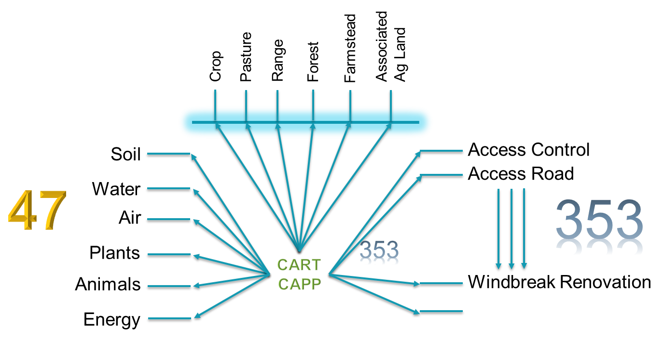
CART Data Collection
Data Collection and Availablity
CART is now collecting tens of millions of data points annually facilitating Environmental Benefits Calculations
CART Data
Plans
Land Units
Resource Concerns
Practice/Systems of Practices
Date Planned/Implemented
Geospatial Extent
Geospatial Lines/Points
Geospatial Polygons
CART Points
Threshold
Existing Condition
Planned Condition (CAPP database)

Slide 8
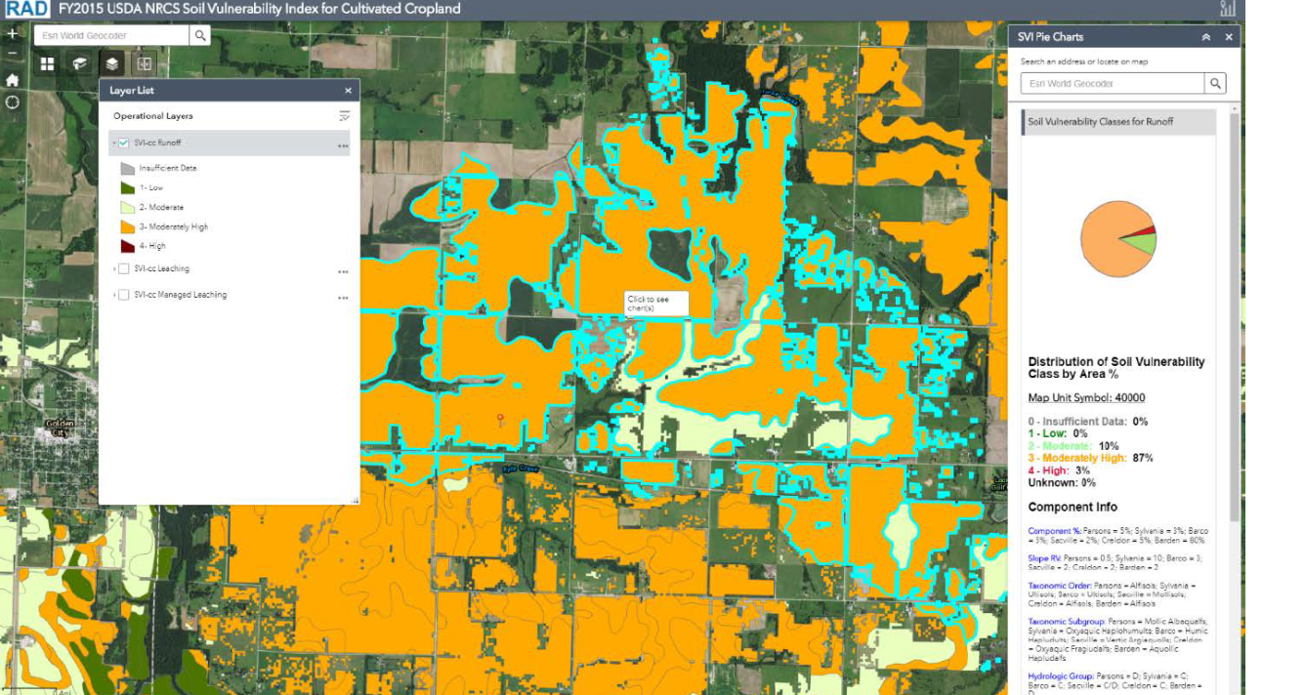
Benefit Development
Levels of Environmental Benefits
Level-1 – Soil Vulnerability Index, Geospatial Layers, Planner Input, and CAPP database => conservation practice has X effect (current for most)
SVI + Geospatial Layers
= Existing Condition –
local based on soils
CAPP = Planned Condition - national at this point

Slide 9
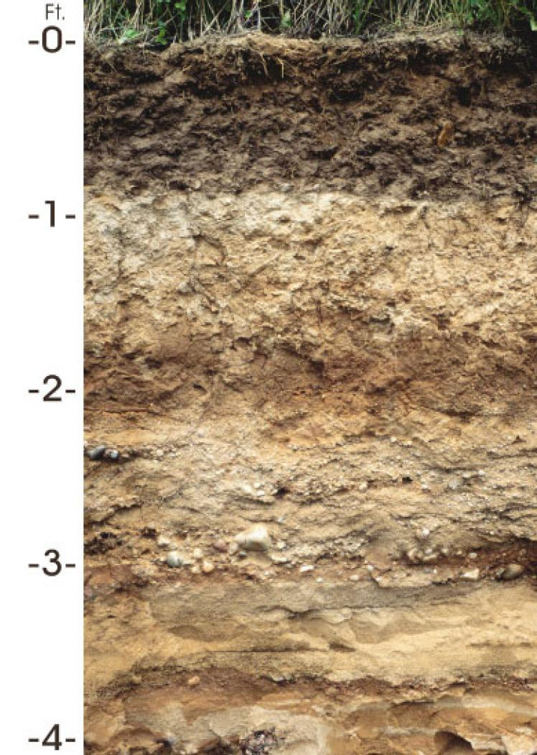
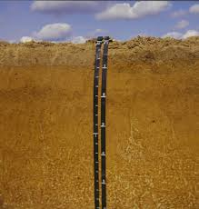
Benefit Development
Levels of Environmental Benefits
Level-2 – CAPP database updated with soil interpretations and/or logic modeling => conservation practice on this soil has X.0 effect (soil interpretations, logic modeling, etc.)
In the works!
Soil Interpretations help
localize the
Environmental Benefits
for conservation practices
like Cover Crops during
conservation planning
Antigo Silt Loam
Tifton Loamy Sand

Slide 10
Benefit Development
Levels of Environmental Benefits
Level-3 – CAPP database updated with practice narratives (e.g. practice intensity) => conservation practice of this intensity, and on this soil, has X.00 effect
Including practice
“narratives” adds to
location details of
Environmental Benefits
for conservation planning

Slide 11
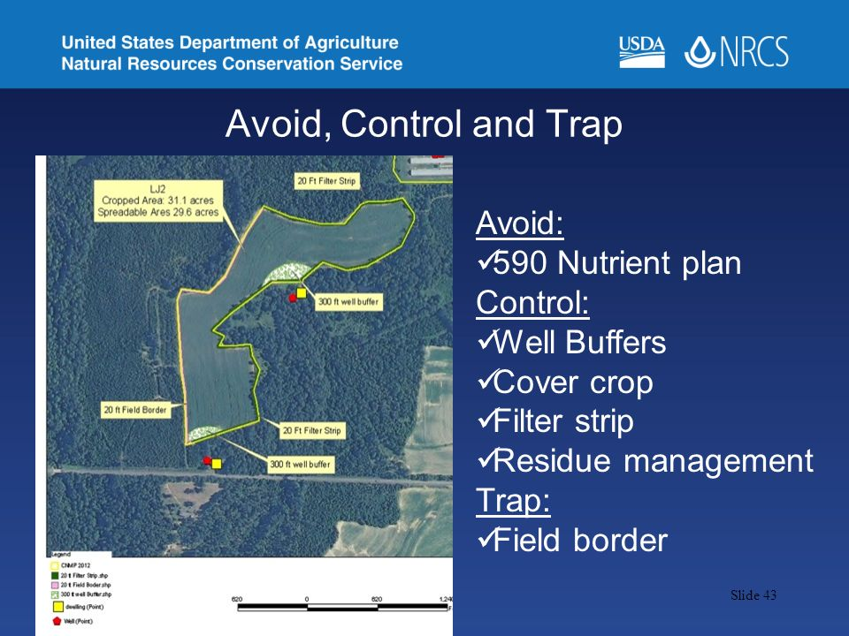
Benefit Development
Levels of Environmental Benefits
Level-4 – CAPP database updated with CEAP data => conservation practice with CEAP modeling, of this intensity, and on this soil has X.000 effect
Including CEAP Science
and Modeling principles
further improves
Planned Conditions
of Environmental Benefits
for conservation planning

Slide 12
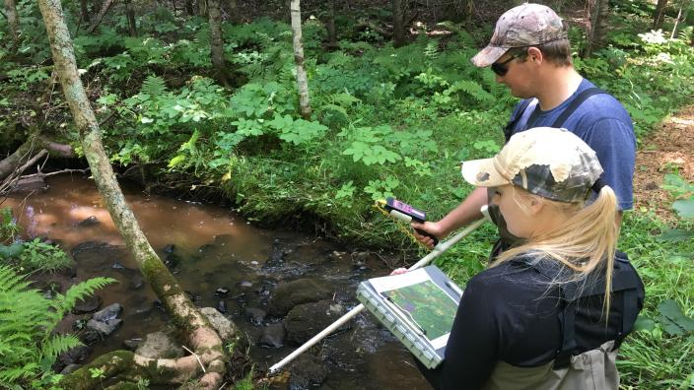
Benefit Development
Levels of Environmental Benefits
Level-5 – CAPP database updated with all the above and empirical data and/or localized literature
Empirical Data Collection
will help fill in the gaps to
calibrate our
CAPP database

Slide 13
Benefit Development
Levels of Environmental Benefits
Level-1 – Soil Vulnerability Index, Geospatial Layers, Planner Input, and CAPP database => conservation practice has X effect (current for most)
Level-2 – CAPP database updated with soil interpretations and/or logic modeling => conservation practice on this soil has X.0 effect (soil interpretations, logic modeling, etc.)
Level-3 – CAPP database updated with practice narratives (e.g. practice intensity) => conservation practice of this intensity, and on this soil, has X.00 effect
Level-4 – CAPP database updated with CEAP data => conservation practice with CEAP modeling, of this intensity, and on this soil has X.000 effect
Level-5 – CAPP database updated with all the above and empirical data and/or localized literature
Note: Levels don’t have to be developed sequentially

Slide 14
Environmental Benefits and Outcomes
Levels of Environmental Benefits
Each combination of Levels
gets Environmental Benefits
closer to better feeding
Outcomes
Outcomes
CEAP-Cropland
CEAP-WLFW
CEAP-Grazing
CEAP-Watersheds
Empirical Data
Literature Reviews
Level-5
Level-4
Conservation Practice Database
Environmental Benefits
Practice Narratives
Level-3
Level-2
Dynamic Soils Properties
Level-1
Conservation Planning:
Land Use, Resource Concerns, Existing Conditions,
Planned Conditions w/Practices, CART Point System

Slide 15
Conservation Planning (CART) Benefits Module
Next Steps
Technical Review Team
Further Develop Environmental Benefits Framework
Evaluate Existing Environmental Benefits Data for readiness
Populate Version 1 Environmental Benefits Data
Explore options to expand and refine (CIG, Academic Study, Data Mining, Partners, CEAP Integration, Soil Interpretations, TSP Program, etc. [i.e. mature Levels of Environmental Benefits on priority basis])
CART Integration
Expand Metis Capacity (Get Funding)
Build Data Structure
Build UI
Build Data Engine
Build Reports and Products

Slide 16
Technical Review

Slide 17
Technical Review
Framework
Small group to evaluate considerations for module framework
Established a baseline for comparison
Consider time horizon of Environmental Benefits
Further develop Data Structure (CART Benefits Module)
Initiate process for modelling and date stamping
Explore public friendly reporting metrics and language, such as dump trucks of soil saved.
Incorporation of data caveats for reporting and usage for:
Conservation Planning and Program Delivery Reporting
Exporting to SSRA for Open Data Reporting and Outcomes

Slide 18
Technical Review
Existing Benefits Data
Create a cross Deputy Chief Search Team for Environmental Benefits data to:
Explore existing data sets for readiness
Develop translations and calculation methodologies
Populate ready data into Environmental Benefits database
Repeat

Slide 19
Technical Review
New Opportunities
Create one or more cross Deputy Chief teams to:
Develop requirements for new Environmental Benefits data development
Advertise opportunities to expand and/or update Environmental Benefits, such as CIG
Explore partnership opportunities and data sharing
Explore added client value opportunities, such as environmental service valuation and environmental markets.

Slide 20
CART Integration

Slide 21
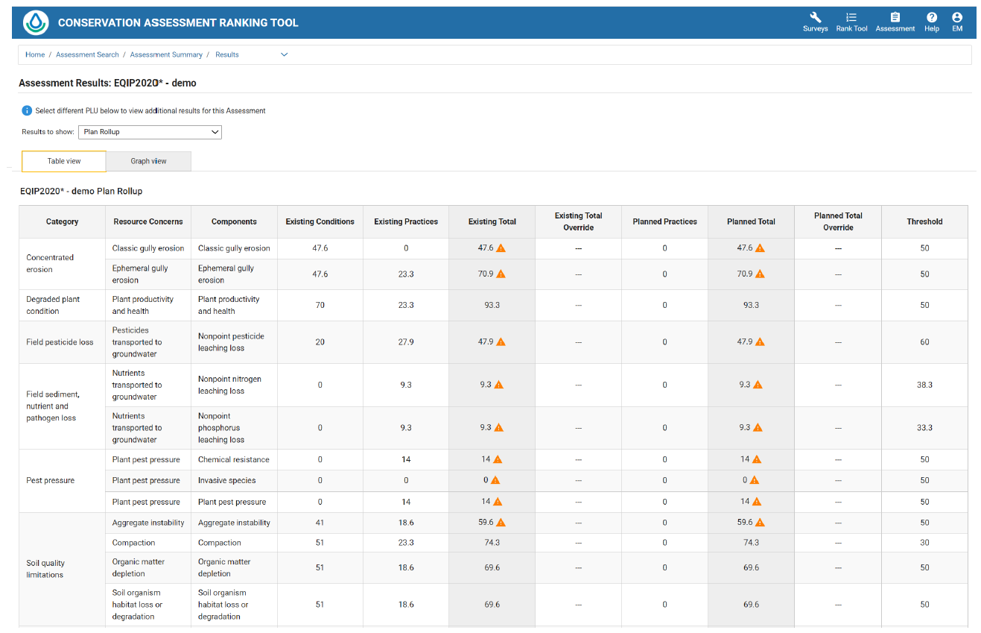
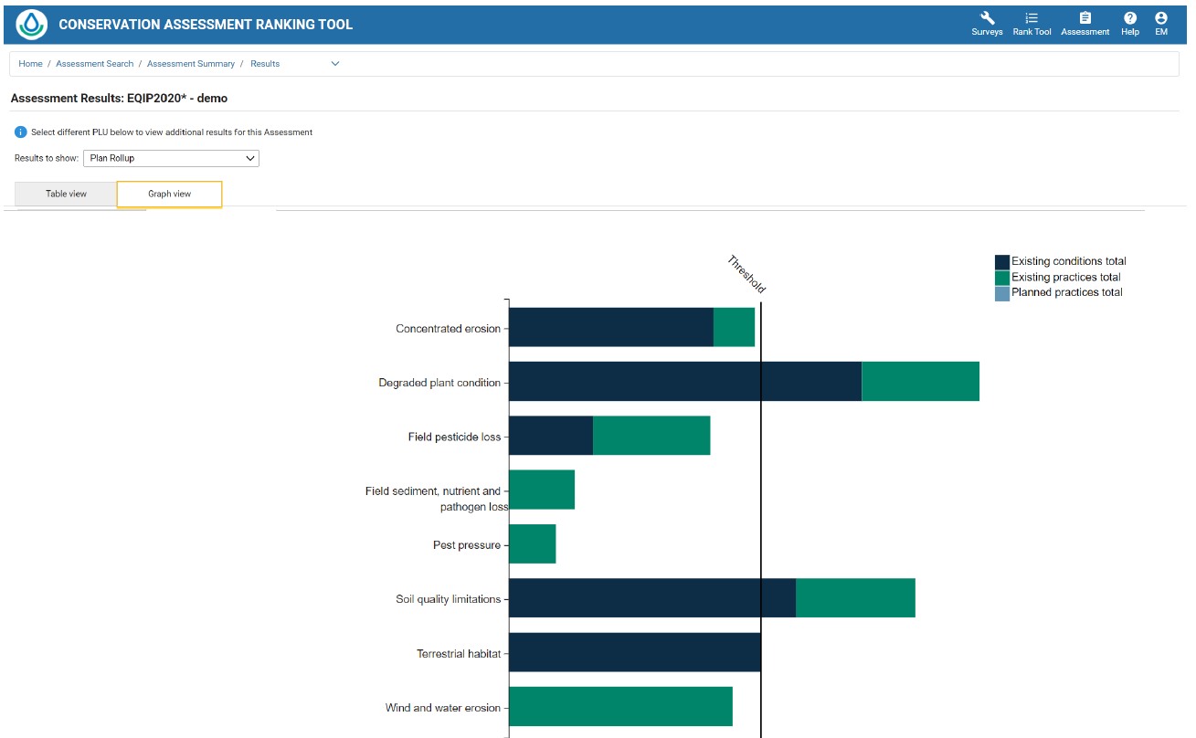
Current CART Results
Table View
Graph View

Slide 22
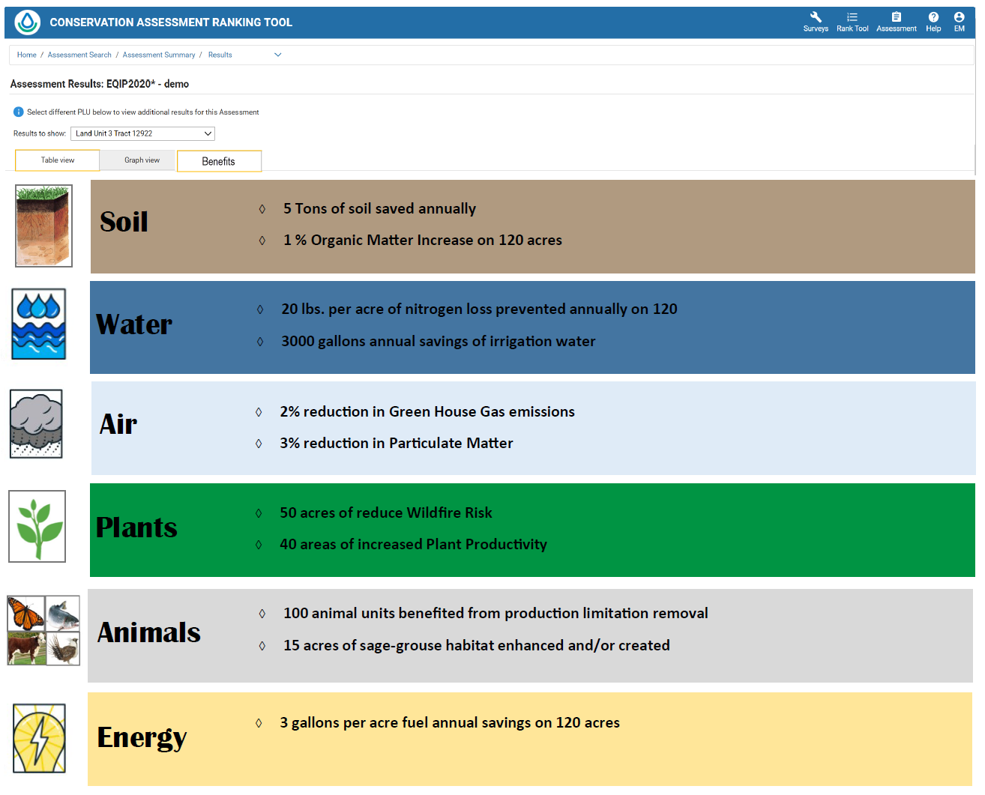
Individual Land Unit Benefits

Slide 23
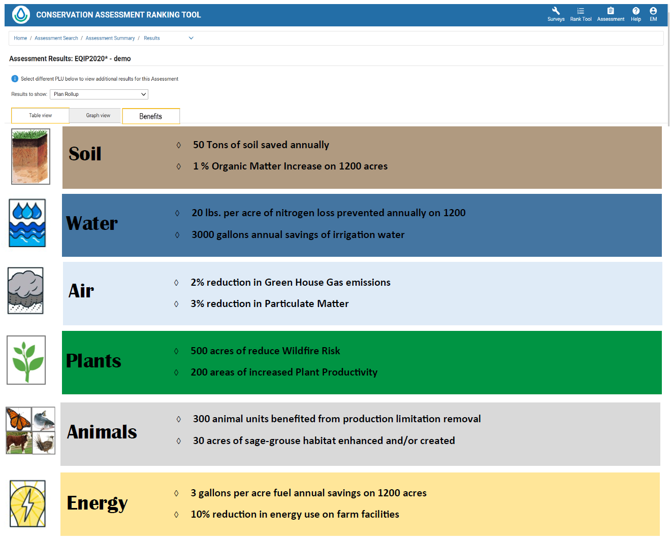
Plan Roll Up Benefits
Outcomes would be based on the RCs evaluated in the assessment
Planned condition – extent above existing benchmark
Appendix would explain how figures were derived
.

Slide 24
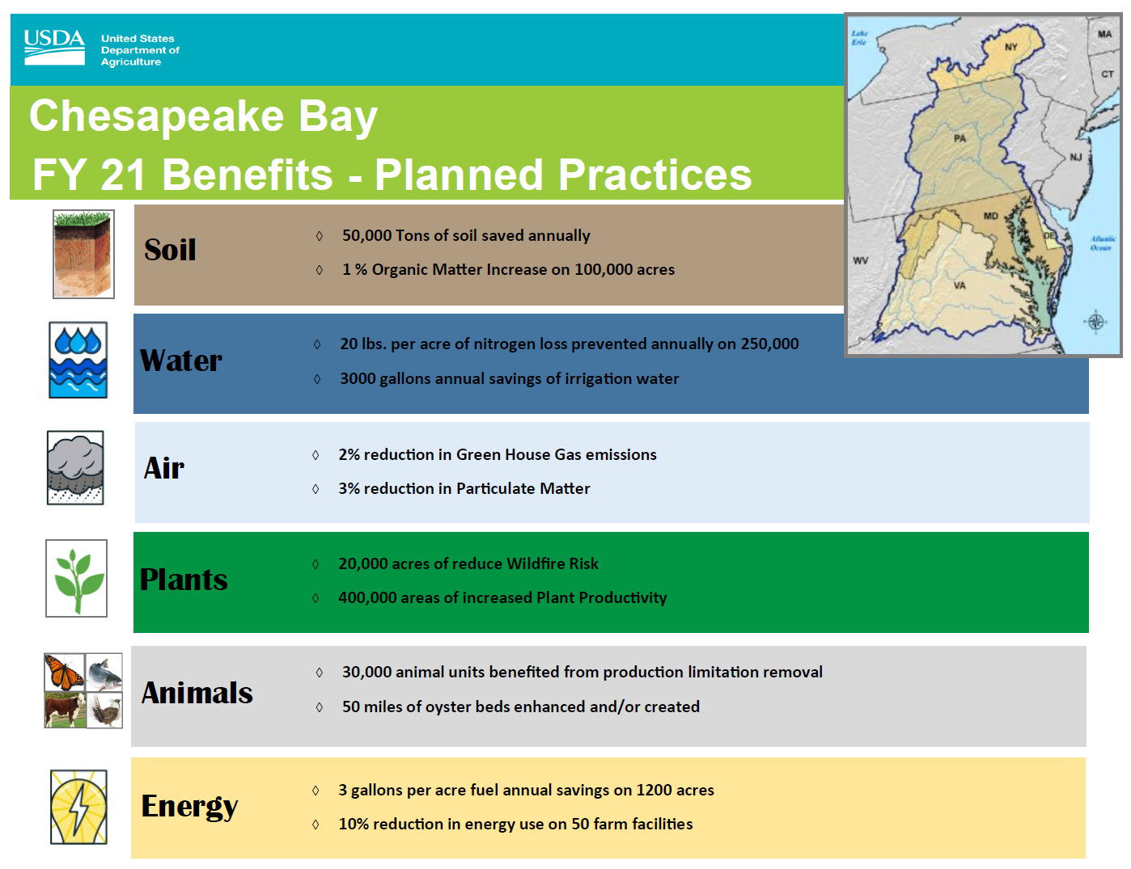
Landscape Benefits

Slide 25
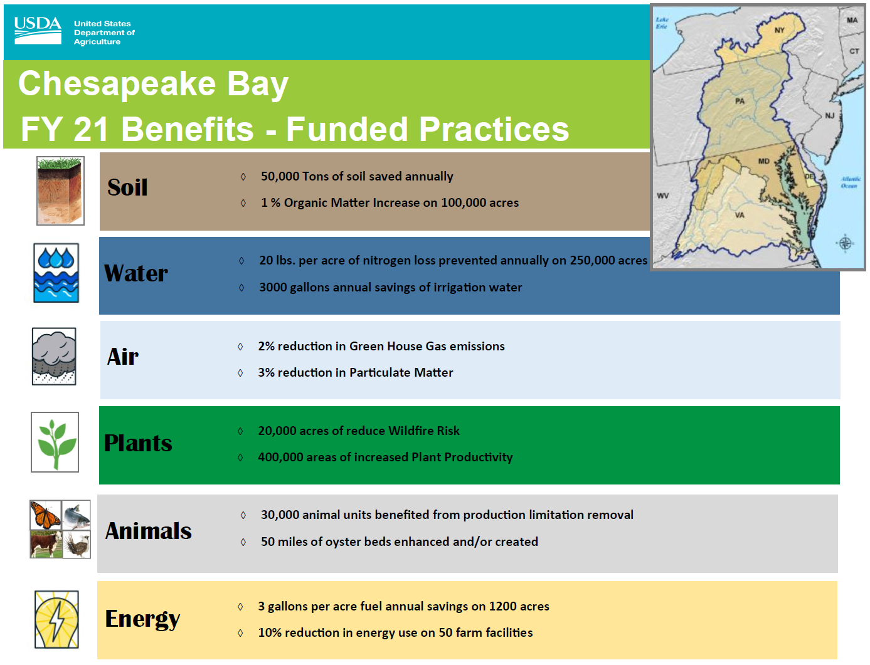
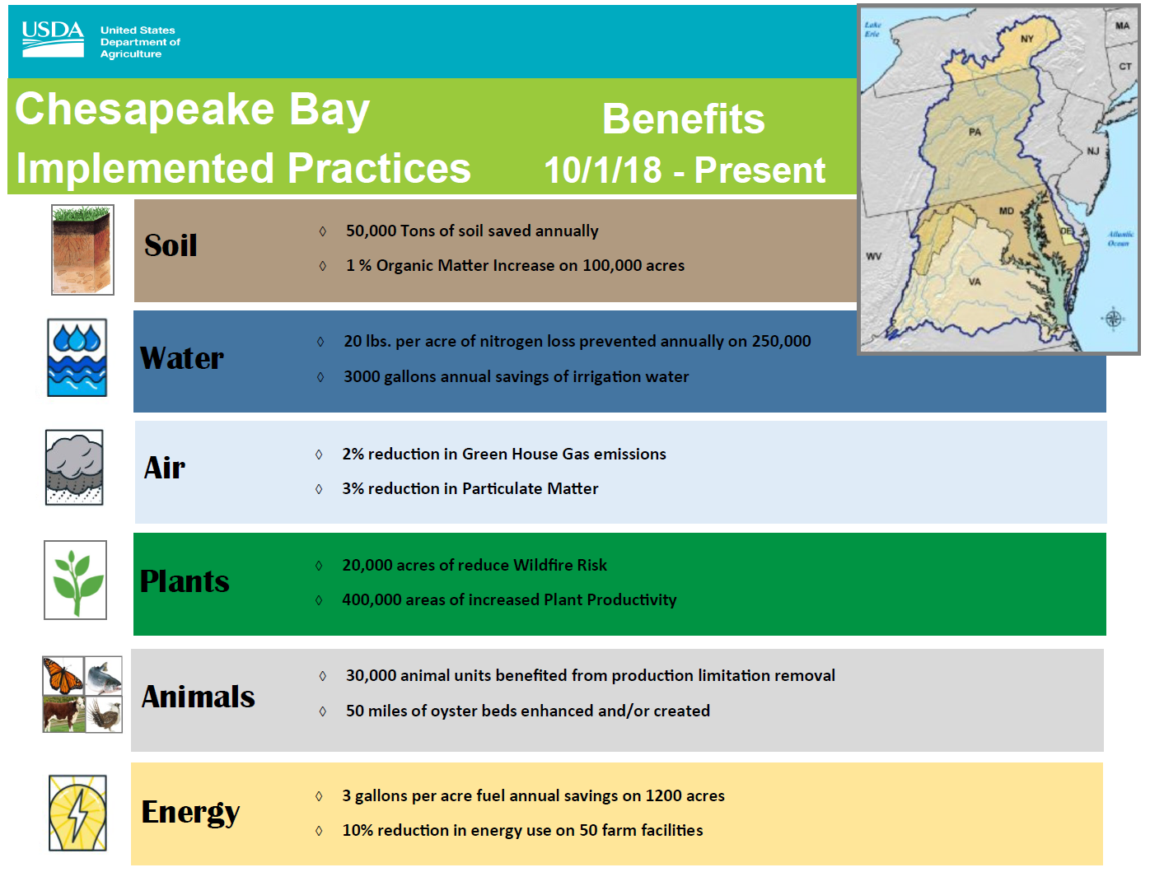
Planned, Funded, Implemented

Slide 26
CART Benefits Module
Environmental Benefits
Dynamic
Soil
Properties
HUB
CEAP, LGU
Research;
Empirical Data
Advanced
Benefits Services
CART Assessment
CART Benefits
Effects Tables
Practice Narrative Based or CART Points Change Based
CART Results
Land Unit/Plan Level
CART Benefits User Interface
Land Unit/Plan Level
Benefits Finder
Benefits Report
Land unit/Plan Level
CART Benefits
Data Storage
Land Unit/Plan Level
RIAD
Outcomes Team
CART Ranking
Efficiency Scoring
Benefits Report
Landscape/Watershed/Level
CD Reports

Slide 27
CART Benefits Module
Features Needed
Features Needed:
Configurable Data Structure at the Land Unit Level
Configurable Benefit Finder and Supporting Benefit Tables
Configurable Land Unit/Plan Level Products
Configurable Landscape/Watershed Level Reports
Beyond MVP:
Service Engine for Advanced Benefits (Integrated w/ surveys)
Environmental Benefits Area Planning Tools (e.g link w/ACPF)
Part of 3-Year IRB Plan

